Slide 1
Opening the Gates to Math Literacy by Opening the Minds of Teachers of Young Children
What teachers need to know in order to help their students

Slide 2
Main Problems: Which ones can we address?
Everyone deserves to be challenged—but appropriately—
There is a difference between confusing and challenging. Do teachers recognize this?
Why is math a gatekeeper? What makes it a gatekeeper?
Poorly prepared teachers?
Poor classroom conditions: no materials, class too large, wide range of students?
Poor administrative support?
Poorly prepared students?
Unsupportive families?
Lack of desire or interest in learning math—
Without the knowledge what gates are closed?
WHAT CAN WE CHANGE?
What do teachers need to know?
Content
Conceptual understanding of content
Ability to assess their students and use that information from a knowledge base that informs them of what interventions will work.
In classroom:
need problems that are rich in content and patterns that allow for explorations for high level students and simpler beginnings students that need them at all levels.
Notes:
Entrance to better classes
Eventually entrance to advanced studies
Entrance to better jobs
The only thing we can truly change is the preparation of our teachers.

Slide 3
Teachers, the first gatekeeper
Teachers at the lower grades have usually not been well trained in math. Often they are the teachers who select to teach at the lower grades because they will not need to know much math. Thus the first gatekeeper is a teacher who is afraid of math and does not know enough to answer questions conceptually and/or correctly. As a result young students are likely to be taught by someone who:
1. does not recognize basic misunderstandings.
2. is so tied to algorithms that the student is unable to get help with number sense.
3. often does not know place value in enough depth to help students when they make an error.
4. does not recognize error patterns because they were not recognized in their own work.
5. has a broad understanding of number but no depth.
6. does not understand the issues around differentiation.
7. does not know how to do meaningful assessments that get at the appropriate variables.
8.likely attended a college where the programs were not very concerned with the math knowledge of their early childhood or special education teachers.

Slide 4
Missed by 31% of the pre-service and in-service teachers:
Cheryl received 58% of the votes cast in an election. If she received 11,857 votes, what is the best estimate of the number of votes cast?
a) 7200 b) 72,000 c) 2000 d) 20,000

Slide 5
44% missed finding parts, wholes, given ratios
120 dollars is divided in the ratio of 2 to 4. The smaller of the amounts is:
a) $80 b) $60 c) $40 d. $100

Slide 6
40% missed the following two problems: rewriting an equation
Which equation could be used to find the number that decreased by 14 equals 51?
a) N÷ 14 = 51 b) N + 14 = 51 c) 51 + 14 = N
d) 51 - N = 14 e) 14N = 51
Which equation could be used to find the number that increased by 14 equals 51?
a) 14N = 51 b) N - 14 = 51 c) 51 - 14 = N
d) 51 + N = 14 e) N ÷ 14 = 51
Notes:
1st graders are often asked to do problems like this

Slide 7
47% had difficulty interpreting remainders in division
What is the largest remainder you can have when you divide by 20?
a) 4 b) 5 c) 10 d) 19 e) 20

Slide 8
46% had difficulty renaming numbers
Which is not another name for 1700?
170 tens b) 17 hundreds c) 1 thousand 70 hundreds
Open-ended version:
How many tens are there in 375?
How upset would you be if the answer was 7?
Do you think base-ten blocks would be useful here?
Notes:
Do you think base 10 blocks would be helpful here?
Why or why not?

Slide 9
Is this model useful? Why or why not?
Notes:
In this model students could easily think that there are 7 tens and just identify it with the place value chart
Look at the arrows as a better model.

Slide 10
41% cannot interpret place value in decimal numbers
In which number is the 4 in the thousandths place?
4315.267 b) 5861.924 c) 8792.346
d) 3695.481 e) none of these

Slide 11
60% cannot solve problems with decimal operations
The speed of sound is 340 meters per second. How long will it take before the sound of the siren reaches your ears if the siren is 68 meters away?
a) 0.2 seconds b) 0.5 seconds c) 2 seconds
d) 5 seconds e) 20 seconds

Slide 12
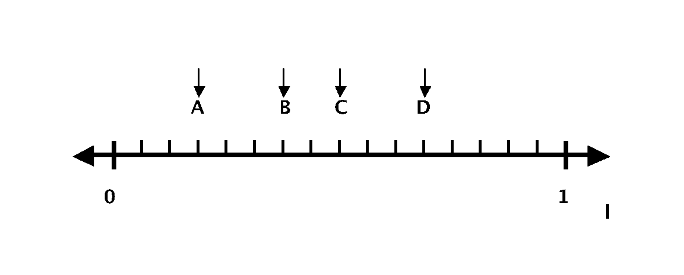
44% cannot locate fractions on the number line
. Which of the numbers on this number line
corresponds to 3/8 ?
a) A b) B c) C d) D e) none

Slide 13
36% have difficulty problem solving with fractions
A carton of compact discs weighs 24 pounds. Each disc weighs 3/8 of a pound. How many discs are in the carton?
a) 9 b) 15 c) 24 d) 32 e) 64

Slide 14
43% have difficulty identifying the appropriate unit of measure
Which of the following is the most appropriate unit to measure the height of a mountain?
a) centimeter b) kilometer c) liter d) meter e) kilogram
36. Which of the following measures would be appropriate for finding the capacity of a trunk?
a) cubic b) mass c) weight d) linear e) square

Slide 15
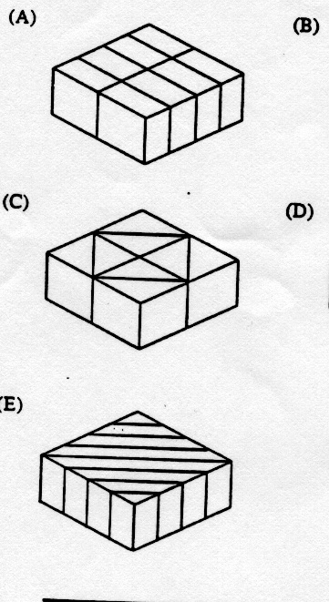
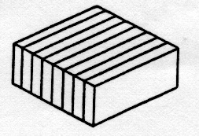
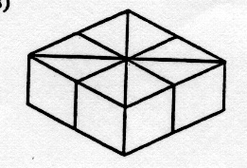
40% couldn’t estimate surface area by counting and estimating
A square shaped cake is uniformly iced on its top and sides. Jane loves icing. Which cake is sliced so she can get a piece with a lot more icing than the others?
Notes:
Is there a cake where they all get the same sized piece?

Slide 16
Here is a problem we can all do, but what would you do if you got these results? ( The student was taught to subtract using the algorithm)
42
-19
37
Notes:
Discuss using unmarked number lines
And 10 frames. Maybe the reck n rack
Most likely not—because it would be mixed with other problems. So the student continues with this problem and teachers tell him to be more careful and he begins to feel dumb.
But he is confusing 51 with 15– and once he says 15 instead of 51 in his mind he computes with 15.

Slide 17
What would you say to a child that gave you this answer to the following:
51
-12
3
Would you mark it wrong and tell the child to be more careful?
What if several weeks later amid some practice problems the student did this:
25 + 51 = 40
Probably nothing. What are the probable consequences?
Notes:
Number ID issue
Here is where the ability to assess comes in.
Are you looking for patterns in errors? If you notice and see that the child is mixing 51 with 15 you can help this child for the rest of his life.
Do you know whether you are confounding errors with other things,

Slide 18
Useful Information
Manipulatives
Useful Questions
Assessment Ideas
Web-sites
References

Slide 19
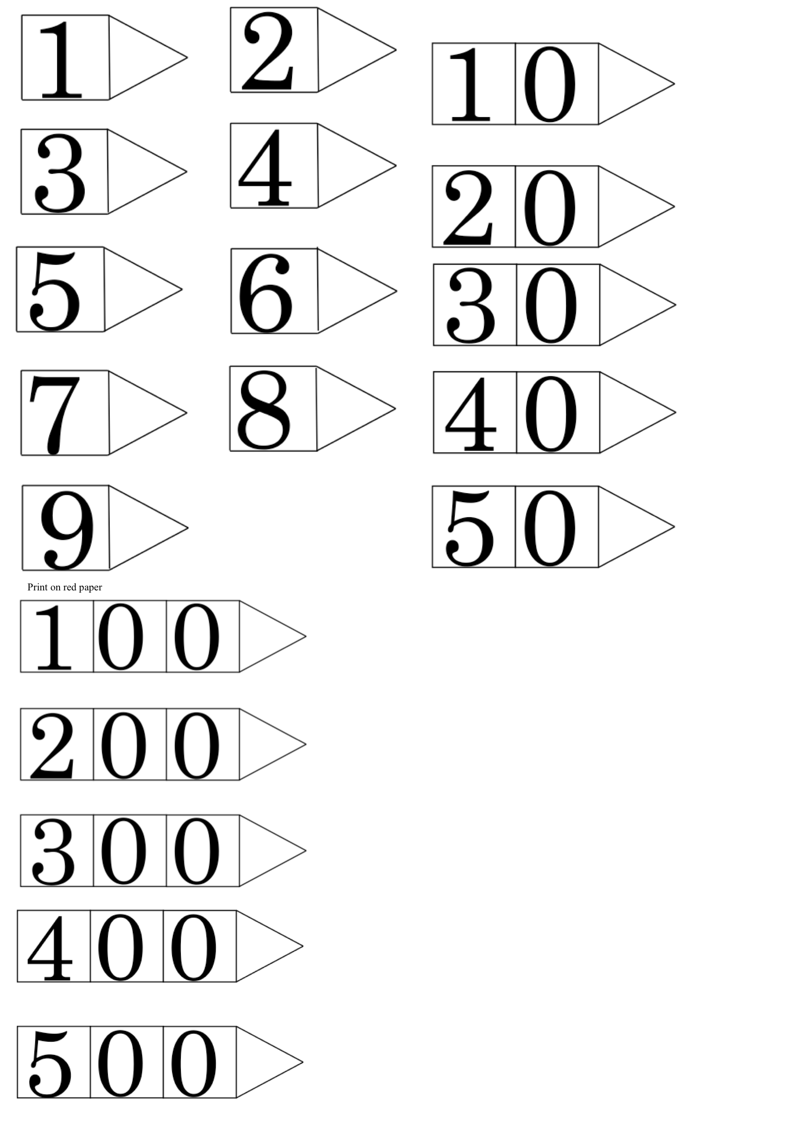
Arrows for place value

Slide 20
%
Decimal
Square
Notes:
Fold to to make decimals or percents.

Slide 21
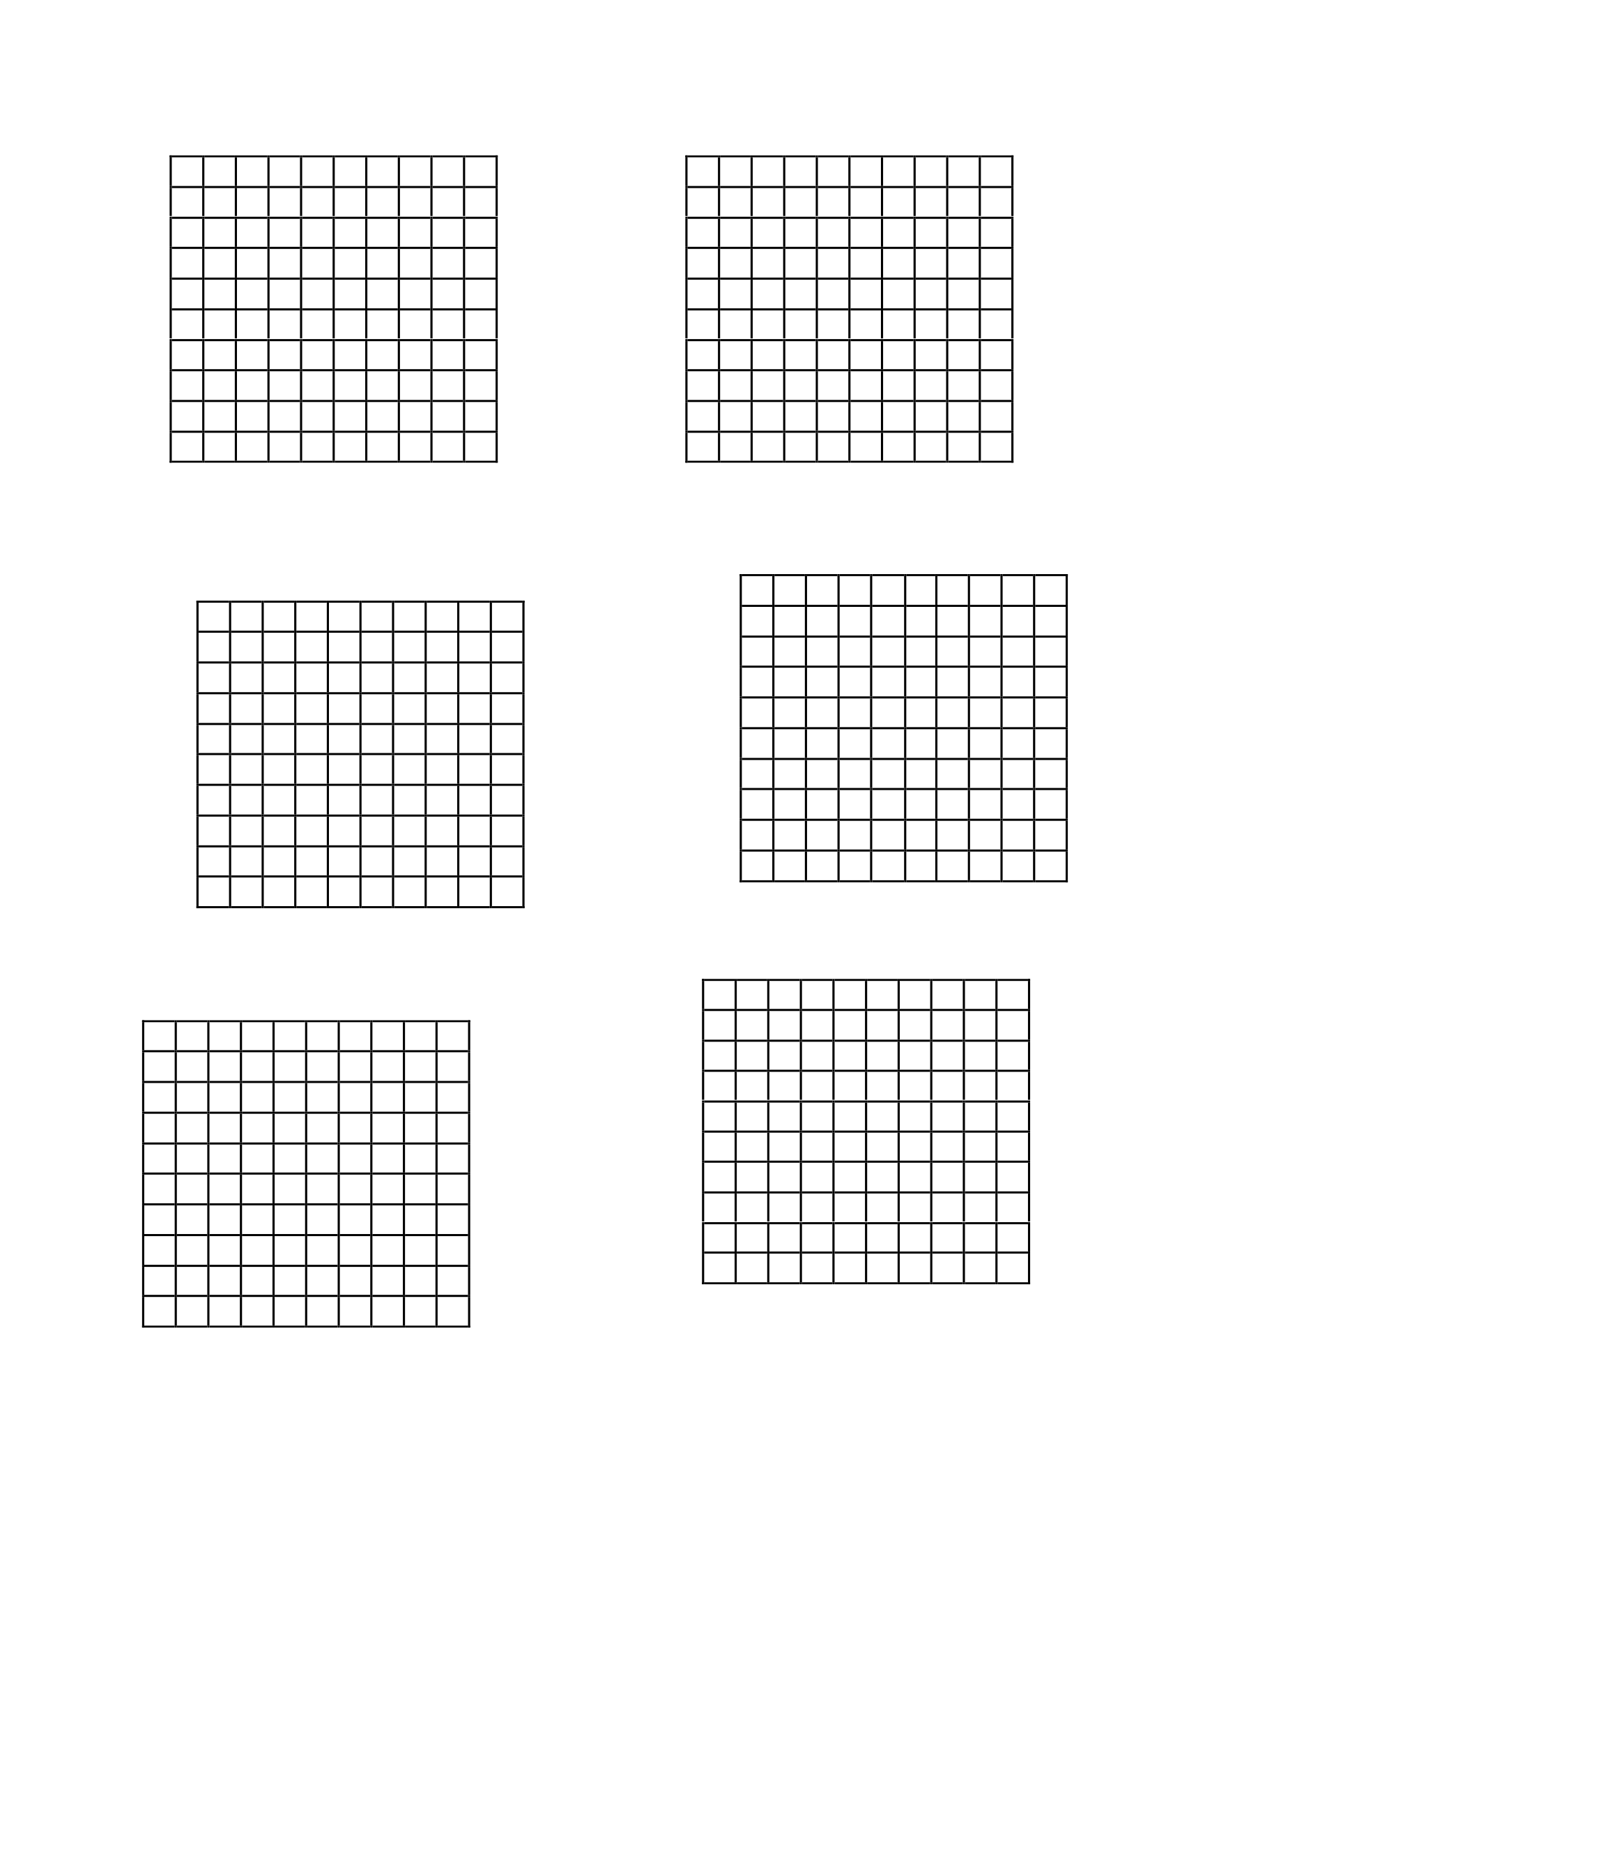
Decimal and percent squares for shading

Slide 22
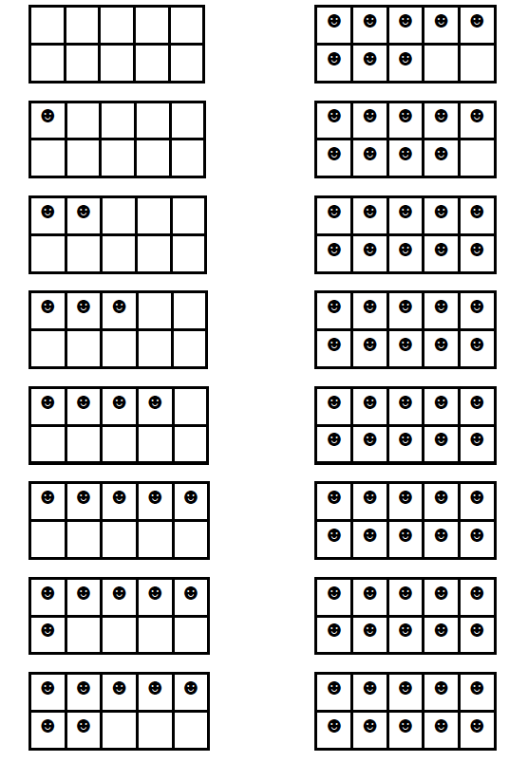
Ten Frames

Slide 23
Part of Equivalence Assessment
1) ______+ _____ = _____ + ______
2) 15 = _____ + _____
3) 15 = _____ - ______
4) 15 = _____ x _____
5) 15 = _____ ÷ ______
Fill in numbers that will make these number sentences correct.
What
Errors
Do you
Expect to
See?
Notes:
What kinds of answers might you expect
If you don’t ask the student why they did certain things what errors can you make? Which ones do you think the student might get wrong?

Slide 24
HELPING STUDENTS WORK TOGETHER TO MAKE SENSE OF MATHEMATICS:
What do others think about what Janine said?
Does anyone have the same answer but a different way to explain it?
Do you understand what Josh is saying?
Can you convince the rest of us that that makes sense?
HELPING STUDENTS RELY MORE ON THEMSELVES TO DETERMINE WHETHER SOMETHING IS MATHEMATICALLY CORRECT:
Why do you think that?
Why is that true?
How did you reach that conclusion?
Does that make sense?
Can you make a model (or demonstrate) to show us your idea?
HELPING STUDENTS TO LEARN TO REASON MATHEMATICALLY:
• Does that always work?
• Can you think of a counterexample?
• How could you prove that?
• What assumptions are you making?
HELPING STUDENTS LEARN TO CONJECTURE, INVENT AND SOLVE PROBLEMS:
What would happen if ?
Do you see a pattern (in the data, in the graph, in the solutions, etc.)?
Can you predict the next one? What about the tenth one?
How did you think about the problem?
What decision do you think he should make?
What is alike and what is different about the two solutions?
HELPING STUDENTS CONNECT MATHEMATICAL IDEAS AND APPLICATIONS:
• How does this relate to ?
• Can you give an example of ?
• What ideas that we have learned before were useful in this situation?
• Have we ever solved a problem like this one before?
• What uses of math did you see on TV or in the newspaper last night? From an NCTM publication

Slide 25
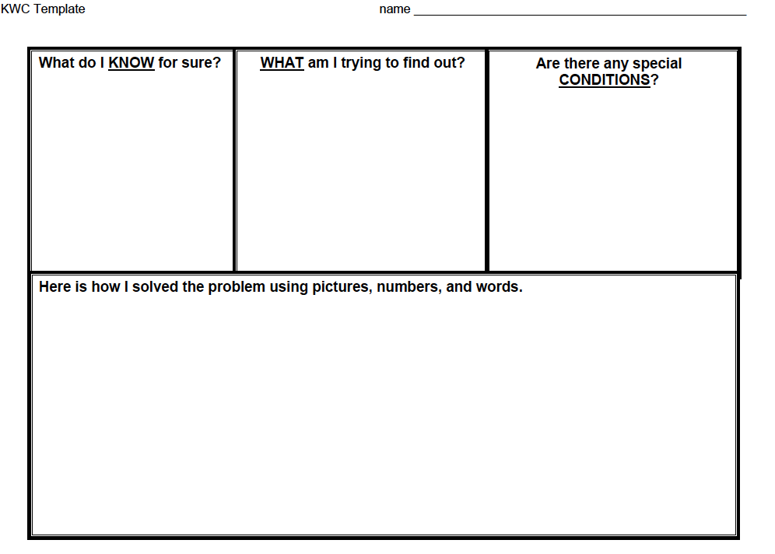
KWC

Slide 26
Ordering cards from 46-55

Slide 27
Arranging cards: 46-55

