Slide 1
Presentation Agenda
Introductions
Ice-breaker Activity:
Homelessness Facts vs. Fiction
Video Presentation
Fly Away Home by Eve Bunting
Model Lesson
Feedback on Lesson
Additional Lesson Ideas
The AVOO Model
Benefits/Challenges
Conclusion

Slide 2
Dr. Edel M. Reilly Julie Anne Bisi, M.Ed.
Recognizing the Absolute Value of All Human Life through Participation in Real Life Scenarios in the Context of Mathematics and Literacy
Creating the Balance in an Unjust World
Brooklyn, New York
October 22-24, 2010

Slide 3
Ice-breaker Activity
“Shaping our Knowledge”
Homelessness:
Facts vs Fiction

Slide 4
Video Presentation: My Own Four Walls © HEAR US 2009

Slide 5
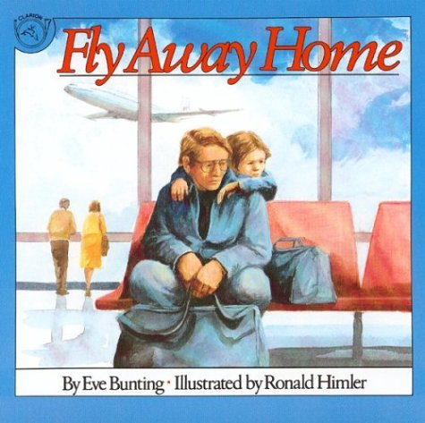
Fly Away Home by Eve Bunting

Slide 6
Model Lesson
Calculating Percents
Estimation
Budgeting with Minimum Wage

Slide 7
Feedback on Lesson

Slide 8
Additional Lesson Ideas
You’re Wonderful by Debbie Clement
Grades K-2
How to Steal a Dog by Barbara O’Connor
Grades 4-5
Soul Moon Soup by Lindsay Lee Johnson
Grades 7-8
Fly Away Home by Eve Bunting
Grade 3 and Grade 5

Slide 9
The AVOO Model
Benefits of Using Children’s Literature to Teach Mathematics
Benefits of Service Learning
Builds Confidence in Political Skills
Promotes Acceptance of Role as Active Citizen
Provides Opportunity to Make Mistakes and Face Fears
Learn to be Comfortable in Uncomfortable Situation
Counters Feeling of Helplessness through Empowerment
Learn to Set Goals and See them Through to Completion
Opens Eyes to Social Realities
Promotes Key Development within the Individual Child
Benefits of Writing in Mathematics
Strengthens Communication Skills
Connects Study of Mathematics to
Real-Life Situations
Validates Purpose of Mathematics
Celebrates Children’s Voice
Encourages Appreciation of Other’s
Thoughts and Opinions
Builds Confidence
Creates Memorable Learning
Experiences
Students See Math Played
Out Through Characters
Stories Have a Natural Appeal
Students of All Ages
Demonstrates the Importance of
Proper Language
Encourages Teamwork and
Collaboration
Stimulates Intellectual
Curiosity
Provides Motivation for
Further Discussion
Helps Students Learn to Effectively
Model Understanding
Application of Concepts to
Formulate Plot

Slide 10
Benefits/Challenges

Slide 11
Conclusion
For more information on The AVOO Model and other related topics, please feel free to contact us:
Dr. Edel M. Reilly Indiana University of Pennsylvania ereilly@iup.edu | Julie Anne Bisi, M.Ed. The Absolute Value of One jbisi3@gmail.com www.juliebisiamyhill.com

