Slide 1
Visualizing Time and Constructing Temples -- Two Projects in Ethnomathematics
Jennifer Wilson
Department of Natural Sciences and Mathematics
Eugene Lang College the New School for Liberal Arts

Slide 2
Game Plan
10:00-10:05 Introduction
10:05-10:15 Discussion of Opening Calendar Questions
10:15-10:25 Calendar Calculations.
10:25-10:35 Introduction of the Tika
10:35-10:50 Tika Problems
10:50-11:00 Discussion of Classroom Implementation
11:00-11:05 Mental Break
11:05-11:15 Introduction of Sulba Sutras and temple construction problems
11:15-11:25 Sulba Sutra Problem Session
11:25-11:30 Wrap-up

Slide 3
General Calendar Questions
What units do we use to measure time?
Which units are based on physical cycles and which units are based on cultural, religious or social conventions?
Which time units are represented in our calendar? How are they represented?
What parts of our calendar stay the same each year? What parts are different?

Slide 4
Calendar Calculations
What day of the week will it be 1000 days from today?
What will be the date 1000 days from today?
How many days are there until Jan. 10, 2013?
What is the largest possible number of Friday the 13th’s in one year?

Slide 5
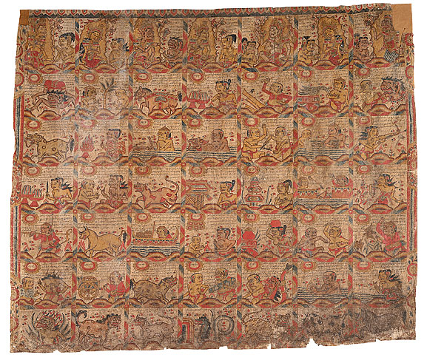
The Tika
The Tika is a representation of the Balinese 210-day Pawukon calendar cycle which marks religious holidays.

Slide 6
The Tika
Read top to bottom and left to right.
Each column represents a wuku or 7-day week.

Slide 7
The Tika
Each day is simultaneously part of a 1-day
week, a 2-day week, a 3-day week, …. a 10
day week.
If today is
(1₁,2₂, 1₃ , 2₄, 3₅, 4₆, 6₇, 6₈, 4₉, 3₁₀),
tomorrow will be
(1₁,1₂, 2₃ , 3₄, 4₅, 5₆, 7₇, 7₈, 5₉, 4₁₀).
The day after will be
(1₁,2₂, 3₃ , 4₄, 5₅, 6₆, 1₇, 8₈, 6₉, 5₁₀).

Slide 8
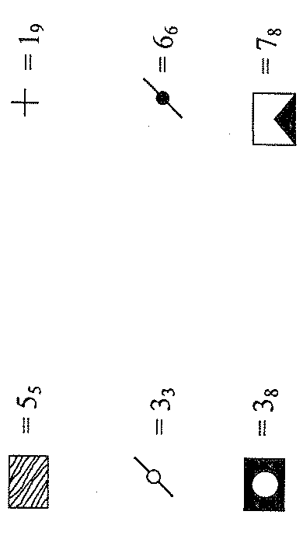
2nd Row 7th Column:
2₇, 5_{5,} 2₃, 4₈, 5_{9,}
(1₁, 2₂, 2₃, 4₄, 5₅, 6₆, 2₇, 4_{8,} 5₉, 5₁₀)

Slide 9
7. (1₁, 1₂, 1₃, 1₄, 2₅, 1₆, 5₇, 5_{8,} 4₉, 2₁₀)
8. (1₁, 2₂, 1₃, 2₄, 1₅, 4₆, 2₇, 2_{8,} 7₉, 1₁₀)
9. 39 days
(mod 2)
(mod 7)
(mod 5)
(mod 4)

Slide 10
Sulba Sutras
Part of the Vedic literature
Four Vedas plus six sections: the Vedas, the Vedangas, the Upanigas, the Upa-Vedas, the Brahmanas and the Pratishakhyas.
Each section has six parts.
The Sulba Sutras are part of the Kalpa Sutras which are part of the Vedengas.
Written prior to 600 BC. Thought to date back to 2000 BC.
Oldest existing geometry texts.

Slide 11
The Sulba Sutras
Consists of Baudhayana, the Apastamba, the Manva and the Katyayana
Contain instructions for building temples according to precise specifications and for solving several related geometric construction problems.
Sulba means “cord” or rope”

Slide 12
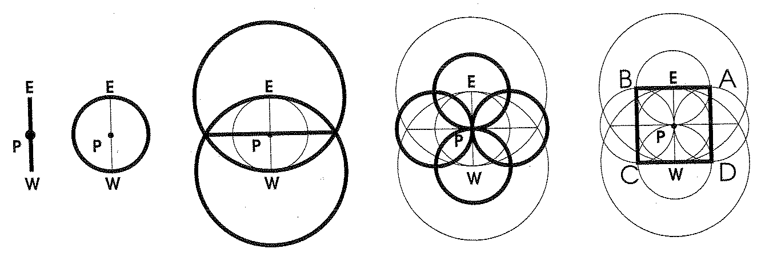
The Sulba Sutras
Constructing a Square

Slide 13
Baudhayana Verse I,48
“The diagonal
of a rectangle
produces both
(areas) which its
length and
breadth produce
separately.”

Slide 14
Baudhayana Verse I,48
“This is seen in
rectangles of sides
three and four,
twelve and five,
fifteen and eight,
seven and twenty-
four, twelve and
thirty-five, fifteen
and thirty-six.”

Slide 15
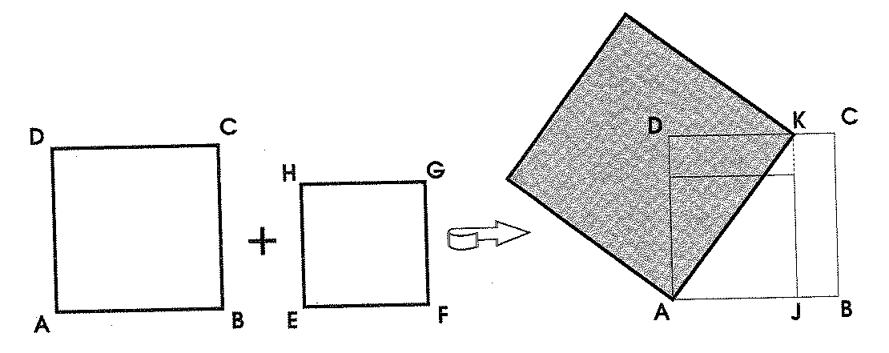
Baudhayana Verse I,50
To construct a square equal to the sum of two unequal squares.
Suppose the two given squares are ABCD and EFGH with AB > EF. Mark off points J, K on AB and DC with AJ = DK = EF. Then the line AK is the side of the required square.

Slide 16
Baudhayana Verse I,51
To construct a square equal to the difference of two unequal squares.
Suppose the two given squares are ABCD and EFGH with AB > EF. Form an arc DL with center A. Then JL is the side of the required square.

Slide 17
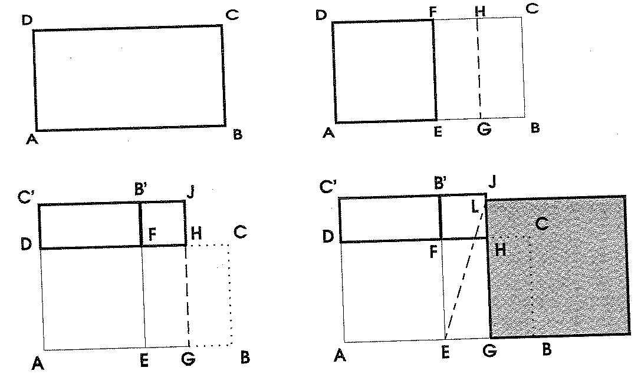
Baudhayana Verse I,54
To construct a square with area equal to a rectangle.
Suppose the rectangle is ABCD with AB > CD. Form a square AEFD. Cut the excess area into two equal parts and place one part on the side of the square.

Slide 18
Baudhayana Verse I,54
Suppose the rectangle is ABCD with AB > CD. Form a square AEFD. Cut the excess area into two equal parts and place one part on the side of the square. This gives two squares, a larger one AGJC’ and a smaller one FHJB’; the required square is the difference of these squares.

Slide 19
Constructing the Citis
Each citi is constructed of 5 layers of brick.
The first, third and fifth have the same pattern; the second and fourth a different pattern.
The patterns are arranged so no joint lies on top or below another.
The most common measurements mentioned in citi construction are the angula (0.75 in) and the purusa (7 ft, 6 in). 120 angulas = 1 purusa
Each layer has roughly 200 bricks.
The bricks have height 6.4 angulas (4.8 in).
The first layer has area 7.5 sq. purusas; the second layer has area 8.5 sq. purusas, etc.

Slide 20
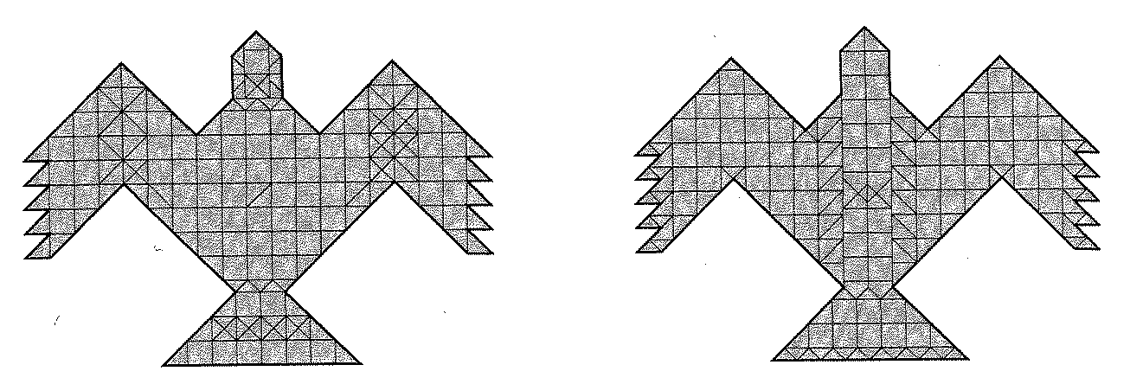
The Syena Citi

Slide 21
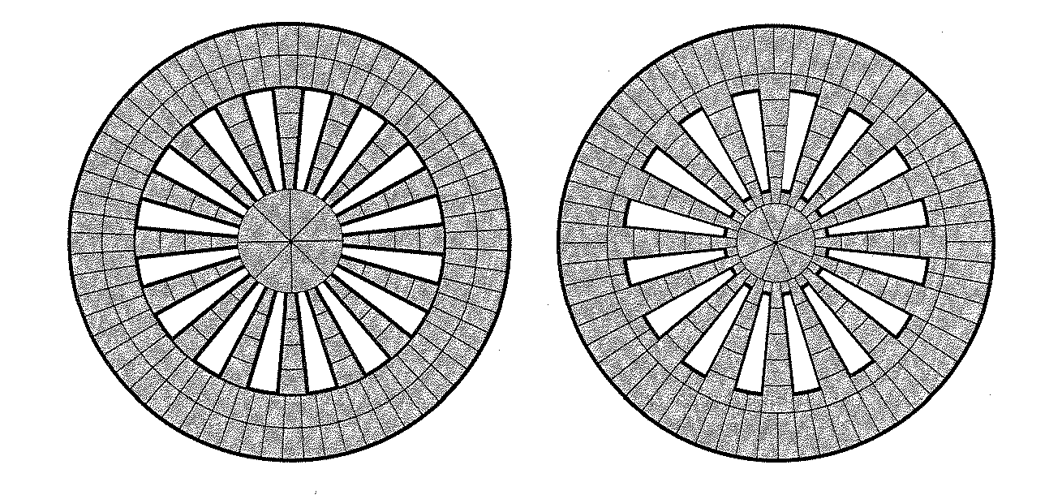
The Rathacakra Citi

Slide 22
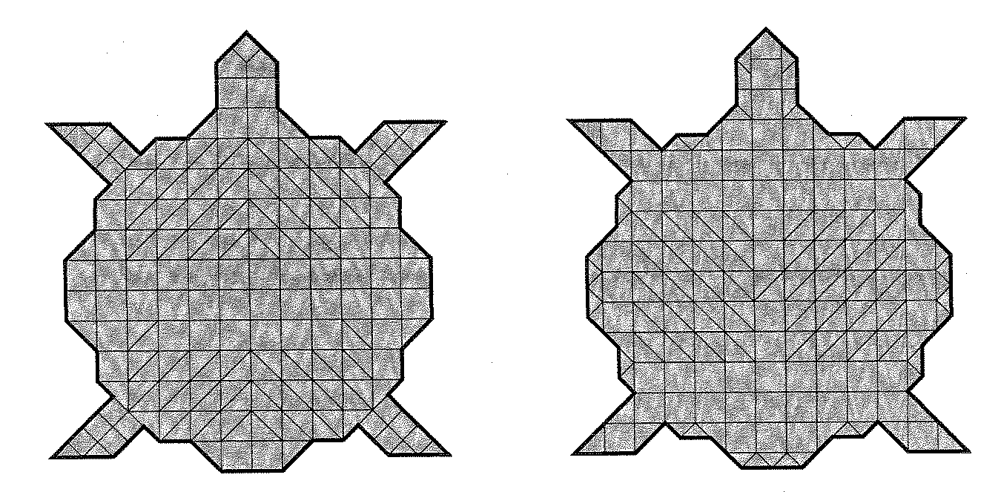
The Kurma Citi

Slide 23
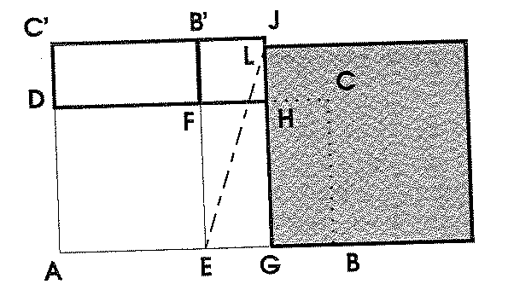
Baudhayana Verse II,12
To increase the size of one layer from 7.5 sq. purusas to 7.5 + q sq. purusas.
Substitute a square of 1 sq. purusas with a square of 1+(2q/15) sq. purusas.
1
The total area will be
sq. purusas.

Slide 24
Square Root of Two Approximation
“Increase the length of the side by its third and this third by its own fourth less the thirty-fourth part of that fourth. The increase length is a small amount in excess.”

Slide 25
Square Root of Two Approximation
Units: prasada (hand span),
angula (thumb width) 1 prasada = 12 angula
sesame seed 1 angula = 34 sesame
seeds
1 pr + 4 ang + 1 ang – 1 sesame seed
= 1 pr + 5 ang – 1 sesame seed

Slide 26
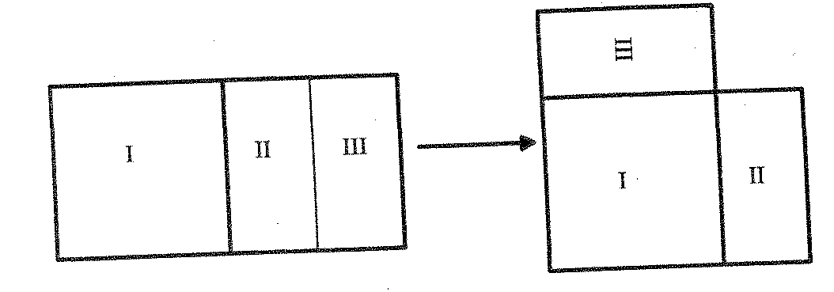
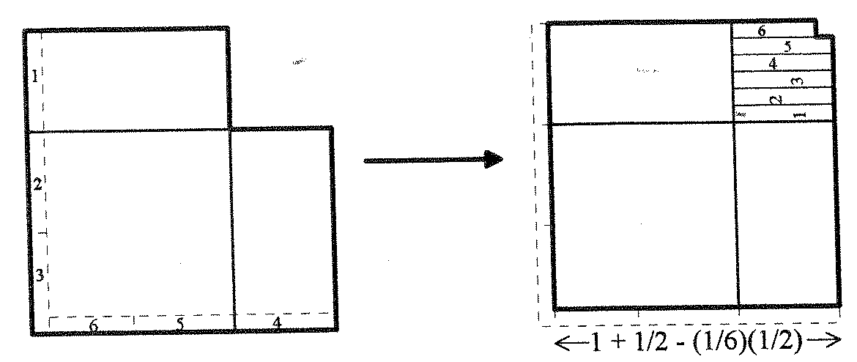
Square Root of Two Approximation (David Henderson)
1 prasada
2 prasada
1 ang

Slide 27
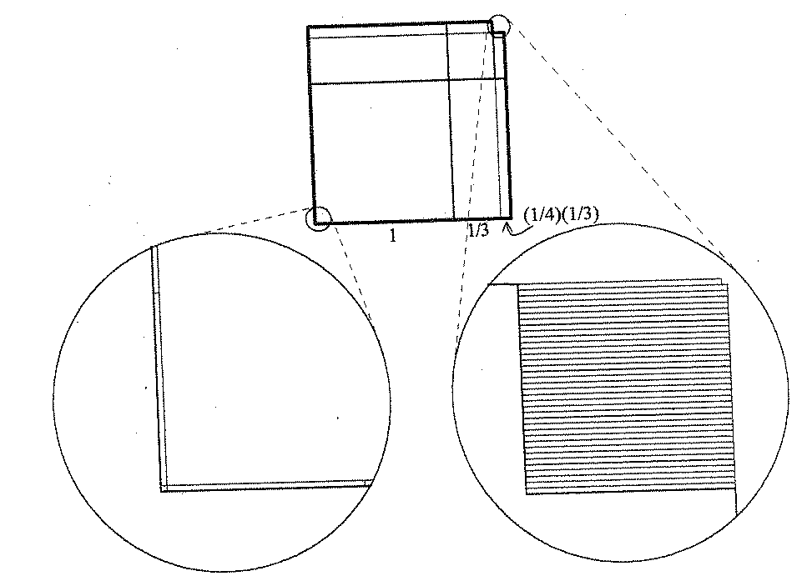
Square Root of Two Approximation (David Henderson)
1 sesame seed

